Slide 1
Use-Case Model: Writing Requirements in Context
Chapter 6
Applying UML and Patterns
-Craig Larman

Slide 2
Use Case Relationships
Business Model
Domain Model
Objects, attributes, associations
VISION
GLOSSARY
SUPPLEMENTARY
SPECIFICATION
Use Case Model
Requirements
Interaction Diagrams
Design

Slide 3
Use Cases are not Diagrams
Use Cases may have a diagram associated with them, and a use case diagram is an easy way for an analyst to discuss a process with a subject matter expert (SME).
But use cases are primarily text. The text is important. The diagram is optional.

Slide 4
Emphasize Goals
Investigating goals rather than tasks and procedures improves information gathering by focusing on the essence of requirements—the intent behind them.
Seeing requirements as identifying tasks to be done has a strong bias toward reproducing the existing system, even when it is being replaced because it is seriously defective.

Slide 5
Why Use Cases?
Simple and familiar story-telling makes it easier, especially for customers, to contribute and review goals.
Use cases keep it simple
They emphasize goals and the user perspective.
New use case writers tend to take them too seriously.

Slide 6
Actors or Use Case First?
Because you have to understand each part of Use Cases, the parts are presented separately. But those who create use cases switch back and forth. The text describes use cases substantially before paying attention to actors. Typically, both actors and use cases are identified early and then examined to see if more use cases can be found from the actors, or more actors found by examining the use cases.

Slide 7
How Use Cases look like?
Capture the specific ways of using the system as dialogues between an actor and the system.
Use cases are used to
  Capture system requirements
  Communicate with end users and Subject Matter Experts
  Test the system

Slide 8
USE CASE : Process Sale
(FULLY DRESSED VERSION)
Primary Actor: Cashier
Stakeholders and Interests:
Cashier: Wants accurate and fast entry, no payment errors, …
Salesperson: Wants sales commissions updated. …
Preconditions: Cashier is identified and authenticated.
Success Guarantee (Post conditions):
Sale is saved. Tax correctly calculated.…
Main success scenario (or basic flow):
Extensions (or alternative flows):
Special requirements: Touch screen UI, …

Slide 9
Use case (contd…)
Technology and Data Variations List:
Identifier entered by bar code scanner,…
Open issues: What are the tax law variations? …
Main success scenario (or basic flow):
The Customer arrives at a POS checkout with items to purchase.
The cashier records the identifier for each item. If there is more than one of the same item, the Cashier can enter the quantity as well.
The system determines the item price and adds the item information to the running sales transaction. The description and the price of the current item are presented.

Slide 10
Use case (contd…)
On completion of item entry, the Cashier indicates to the POS system that item entry is complete.
The System calculates and presents the sale total.
The Cashier tells the customer the total. The Customer gives a cash payment (“cash tendered”) possibly greater than the sale total.
Extensions (or alternative flows):
If invalid identifier entered. Indicate error.
If customer didn’t have enough cash, cancel sales transaction.

Slide 11
Things that are in Use Cases
Create a written document for each Use Case
  Clearly define intent of the Use Case
  Define Main Success Scenario (Happy Path)
  Define any alternate action paths
  Use format of Stimulus: Response
  Each specification must be testable
  Write from actor’s perspective, in actor’s vocabulary

Slide 12
Use cases Template source: www.usecases.org
Name
Primary Actor
Scope
Level
Stakeholders and Interests
Minimal Guarantee
Success Guarantee
Main Success Scenario
Extensions

Slide 13
Optional Items
You can add some of the following items
  Trigger (after Success Guarantee)
(at end:)
  Special requirements (interests of actors)
  Technology and Data Variations
  Frequency of Occurrence
  Open Issues (various business decisions)

Slide 14
Goals and Scope of a Use Case
At what level and scope should use cases be expressed?
􀂄 A: Focus on uses cases at the level of elementary business process (EBP).
EBP: a task performed by one person in one place at one time which adds measurable business value and leaves the data in a consistent state.
Approve credit order - OK.
Negotiate a supplier contract - not OK.
It is usually useful to create separate “sub” use cases representing subtasks within a base use case. e.g. Paying by credit

Slide 15
Elements in the Preface
Only put items that are important to understand before reading the Main Success Scenario.
These might include:
Name (Always needed for identification)
Primary Actor
Stakeholders and Interests List
Preconditions
Success guarantee (Post Conditions)

Slide 16
Naming Use Cases
Must be a complete process from the viewpoint of the end user.
Usually in verb-object form, like Buy Pizza
Use enough detail to make it specific
Use active voice, not passive
From viewpoint of the actor, not the system

Slide 17
Golden Rule of Use-Case Names
Each use case should have a name that indicates what value (or goal) is achieved by the actor's interaction with the system
Here are some good questions to help you adhere to this rule:
  Why would the actor initiate this interaction with the system?
  What goal does the actor have in mind when undertaking these actions?
  What value is achieved and for which actor?

Slide 18
Use Case Name Examples
Excellent - Purchase Concert Ticket
Very Good - Purchase Concert Tickets
Good - Purchase Ticket (insufficient detail)
Fair - Ticket Purchase (passive)
Poor - Ticket Order (system view, not user)
Unacceptable - Pay for Ticket (procedure, not process)

Slide 19
CRUD
Examples of bad use case names with the acronym CRUD. (All are procedural and reveal nothing about the actor’s intentions.)
C - actor Creates data
R - actor Retrieves data
U - actor Updates data
D - actor Deletes data

Slide 20
Identify Actors
We cannot understand a system until we know who will use it
  Direct users
  Users responsible to operate and maintain it
  External systems used by the system
  External systems that interact with the system

Slide 21
Types of Actors
Primary Actor
  Has goals to be fulfilled by system
Supporting Actor
  Provides service to the system
Offstage Actor
  Interested in the behavior, but no contribution
In diagrams, Primary actors go on the left and others on the right.

Slide 22
Define Actors
Actors should not be analyzed or described in detail unless the application domain demands it.
Template for definition:
  Name
  Definition
Example for an ATM application:
Customer: Owner of an account who manages account by depositing and withdrawing funds

Slide 23
Working with Use Cases
Determine the actors that will interact with the system
Examine the actors and document their needs
For each separate need, create a use case
During Analysis, extend use cases with interaction diagrams

Slide 24
Preconditions
Anything that must always be true before beginning a scenario is a precondition.
Preconditions are assumed to be true, not tested within the Use Case itself.
Ignore obvious preconditions such as the power being turned on. Only document items necessary to understand the Use Case.

Slide 25
Success Guarantees
Success Guarantees (or Post conditions) state what must be true if the Use Case is completed successfully. This may include the main success scenario and some alternative paths. For example, if the happy path is a cash sale, a credit sale might also be regarded a success.
Stakeholders should agree on the guarantee.

Slide 26
Scenarios
The Main Success Scenario, or “happy path” is the expected primary use of the system, without problems or exceptions.
Alternative Scenarios or Extensions are used to document other common paths through the system and error handling or exceptions.

Slide 27
Documenting the Happy Path
The Success Scenario (or basic course) gives the best understanding of the use case
Each step contains the activities and inputs of the actor and the system response
If there are three or more items, create a list
Label steps for configuration management and requirements traceability
Use present tense and active voice
Remember that User Interface designers will use this specification
Note: Do not use the term “happy path” in formal documents.

Slide 28
Documenting Extensions
Use same format as Happy Path
Document actions that vary from ideal path
Include error conditions
Number each alternate, and start with the condition:
3A. Condition: If [actor] performs [action] the system …
If subsequent steps are the same as the happy path, identify and label as (same)
Steps not included in alternate course are assumed not to be performed.

Slide 29
Two Parts for Extensions
Condition
  Describe the reason for the alternative flow as a condition that the user can detect
Handling
  Describe the flow of processing in the same manner as the happy path, using a numbering system consistent with the original section.

Slide 30
Special Requirements
If a non-functional requirement , quality attribute, or constraint affects a use case directly, describe it as a special requirement.

Slide 31
Technology and Data Variations List
Often there are technical differences in how things are done even though what is done is the same. These things can be described in the Technology and Data Variations List.
For example, if a card reader cannot read the magnetic stripe on a credit card, the cashier might be able to enter it on the keyboard.

Slide 32
Types of Use Cases
The most common Use Cases are High Level Use Cases and Expanded Essential Use Cases in analysis, and Expanded Real Use Cases in design. The next slide gives definitions.
In addition, Use Case diagrams may be used in discussions with stakeholders while capturing their requirements.

Slide 33
Elaborating Use Cases
High Level Use Case (Brief)
  Name, Actors, Purpose, Overview
Expanded Use Case (Fully Dressed)
  Add System Events and System Responses
Essential Use Case (Black Box)
  Leave out technological implications
Real Use Case (White Box)
  Leave in technology

Slide 34
Defer Decisions
By using essential use cases as long as possible, and only using real use cases during module design, you allow time to understand the problem before you create a solution. Premature use of real use cases often confirms existing technology when a better technology might be available.

Slide 35
Technology
The distinction between an essential (black box) use case that leaves out technology and a real (white box) use case that includes technology is fundamental.
For example, in an Automated Teller Machine, an essential use case can mention identification or validation, but only a real use case can mention a key pad or card reader.

Slide 36
Expanded Essential
Use Cases
How to make one:
  Step 1: Name the Use Case (system function, e.g. “enter timesheet information”).
  Step 2: Identify the Actor(s) involved.
  Step 3: Describe the Intent of the Use Case in language the client will understand.
  Step 4: Identify the Assumptions and Limitations relevant to this Use Case and other Use Cases which the current one might extend or build upon.
  Step 5: Specify the ideal flow of actions using two columns labeled “Actor Actions” and “System Responses.” Number each step. This constitutes the Happy Path for this Use Case.
  Step 6: Identify opportunities for user error and create an Alternative Path to handle each.
Notes:
The Expanded Essential Use Case is a transition document between the Analysis phase and the Design phase of software development. During this transition, documents are created less and less in langage of the client, and more and more in the language of the computer programmer. For Expanded Essential Use Cases there are two main goals: 1) to give the client an idea of what it will be like for the user to actually use the system and 2) to give the developer a start on developing system objects and pseudocode.
With the Expanded Essential Use Case, the developer will be able to identify major events during system use and translate them into event contracts and function specifications.
Each specification must describe something tangible and testable so that once the system has been completed it can be demonstrated that the Use Case was satisfied.

Slide 37
Post conditions
Post conditions (or success guarantees) state what always must be true for a use case to succeed. Avoid the obvious, but clearly document any that are not obvious. This is one of the most important parts of a use case.

Slide 38
Conditions and Branching
Stick to the “Happy Path,” “Sunny Day Scenario,” Typical Flow, or Basic Flow (all names for the same basic idea) in the main section and defer all conditional sections and branching to the extensions or alternate flows.

Slide 39
Extension Use Cases
Users appreciate simplicity, so most use cases leave out alternate courses
You can do this by extending the use case while leaving the original use case alone

Slide 40
Feature Lists
Older methods of detailing requirements tended to have many pages of detailed feature lists. Usually the details could not be seen in context.
Current philosophy is to use a higher level of detail with use cases instead of a list.
High level System Feature Lists are acceptable when they can give a succinct summary of the system.

Slide 41
Use Cases not an OO idea
Use Cases are not an Object-Oriented methodology. They are common in structured development as well.
However, the Unified Process encourages use-case driven development.

Slide 42
Use-case driven development
Requirements are primarily recorded in the Use Case model.
Iterations are planned around implementing particular Use Cases.
Use Case Realizations drive design.
Use Case often influence the way user manuals are organized.

Slide 43
Use Cases are always wrong!
Written documentation gives the illusion of authority and correctness, but it is an illusion.
Use cases give a preliminary understanding that users and developers can discuss and agree on.
But there should be constant feedback from customers in the development process to correct missing information and misinformation before it jeopardizes the functionality of the program.

Slide 44
Diagramming Use Cases
The text is the Use Case!
Diagrams may supplement the text or help during discovery.

Slide 45
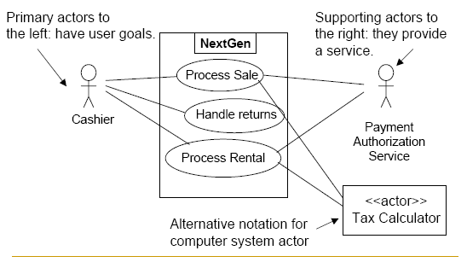
Overview
A use case diagram identifies transactions between actors and a system as individual use cases

Slide 46
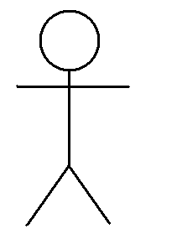
Actor
An actor is an idealized user of a system
Actors can be users, processes, and other systems
Many users can be one actor, in a common role
One user can be different actors, based on different roles
An actor is labeled with the name of the role

Slide 47
Non-human Actor
Actors can be users, processes, and other systems.
Show non human actors in a different manner, usually as a rectangle
Non human actors are usually not primary users, and thus are usually shown on the right, not the left.
Inventory
System

Slide 48
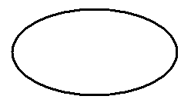

Use Case
A use case is a coherent unit of externally visible functionality provided by a system and expressed by a sequence of messages
Additional behavior can be shown with parent-child, extend and include use cases
It is labeled with a name that the user can understand

Slide 49
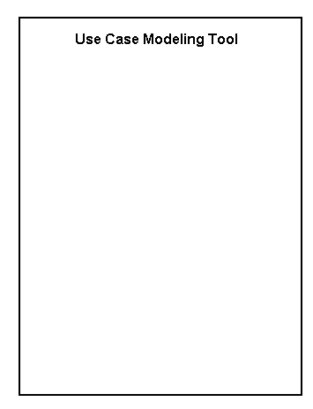
System
A system is shown as a rectangle, labeled with the system name
Actors are outside the system
Use cases are inside the system
The rectangle shows the scope or boundary of the system
Don’t forget the boundary and the system name, unless you are using Rational Rose!

Slide 50
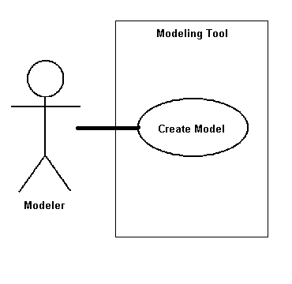
Association Relationship
An association is the communication path between an actor and the use case that it participates in
It is shown as a solid line
It does not have an arrow, and is normally read from left to right
Here, the association is between a Modeler and the Create Model use case

Slide 51
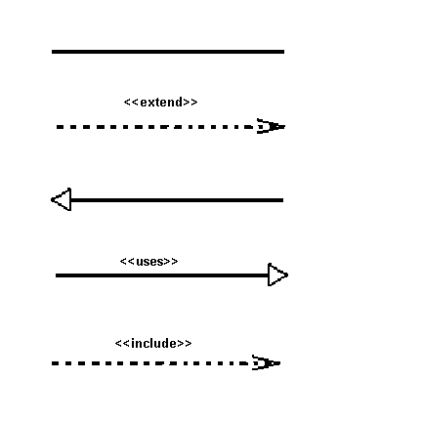
Relationships in Use Cases
There are several Use Case relationships:
Association
Extend
Generalization
Uses
Include
Most Use Cases have only associations. Use other relationships sparingly.

Slide 52
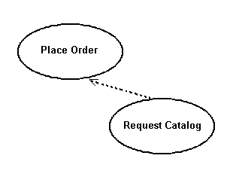
Extend Relationship
Extend puts additional behavior in a use case that does not know about it.
It is shown as a dotted line with an arrow point and labeled <<extend>>
In this case, a customer can request a catalog when placing an order

Slide 53
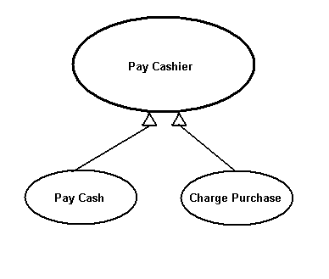
Use Case Generalization
Generalization is a relationship between a general use case and a more specific use case that inherits and extends features to it
It is shown as a solid line with a closed arrow point
Here, the payment process is modified for cash and charge cards

Slide 54
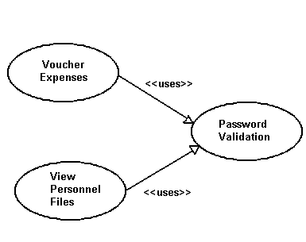
Uses Relationship
When a use case uses another process, the relationship can be shown with the uses relationship
This is shown as a solid line with a closed arrow point and the <<uses>> keyword
Here different system processes can use the logon use case

Slide 55
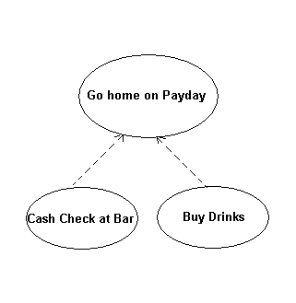
Include Relationship
Include relationships insert additional behavior into a base use case
They are shown as a dotted line with an open arrow and the key word <<include>>
Shown is a process that I observed in an earlier career

Slide 56
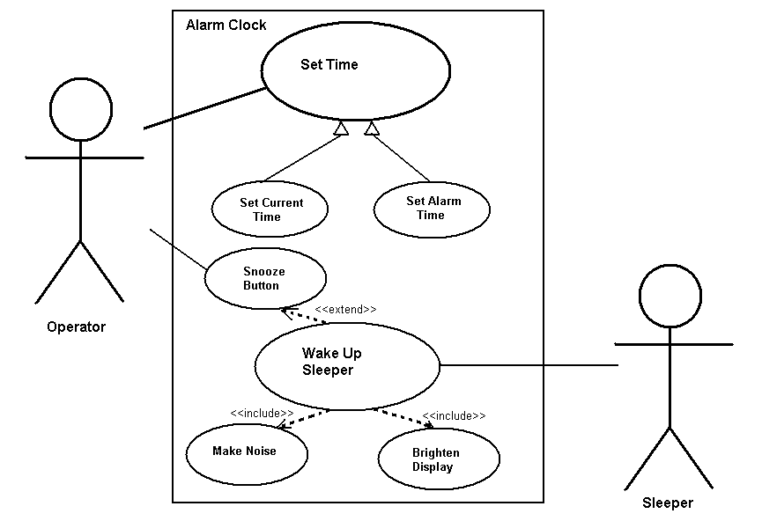
Use Case Example: Alarm Clock
This is a contrived
example, to show
many relations.
Your diagrams
should be simpler.

